Slide 1
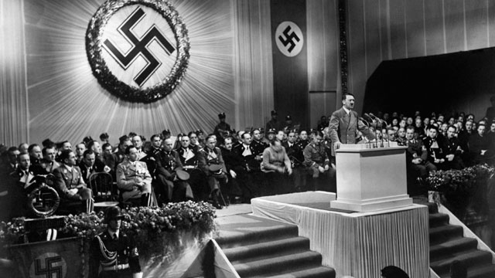
Taking Complete Power
Hitler’s takeover of government after January 1933

Slide 2
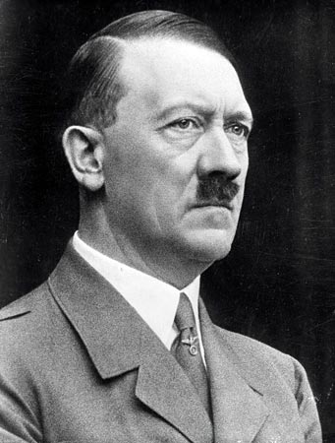
From Chancellor to Führer
January 1933 = Chancellor
August 1934 = Führer
What happened during this time that allowed Hitler to take the ultimate leap from democratic leader to dictator?
Notes:
2

Slide 3
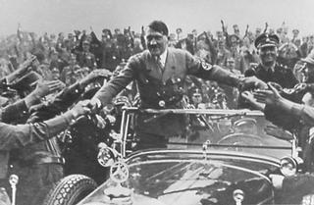
Hitler’s Election Success
Hitler and the Nazi Party had been doing well in elections.
However they still did not have a majority in the Reichstag.
Nevertheless, Hitler was still asked to become Chancellor of Germany.
Notes:
3

Slide 4
Hitler as Chancellor
Hitler had no intention of abiding by the rules of democracy.
He intended only to use those rules to legally establish himself as dictator as quickly as possible, then begin the Nazi revolution.
Even before he was sworn in, he was at work to accomplish that goal by demanding new elections.

Slide 5
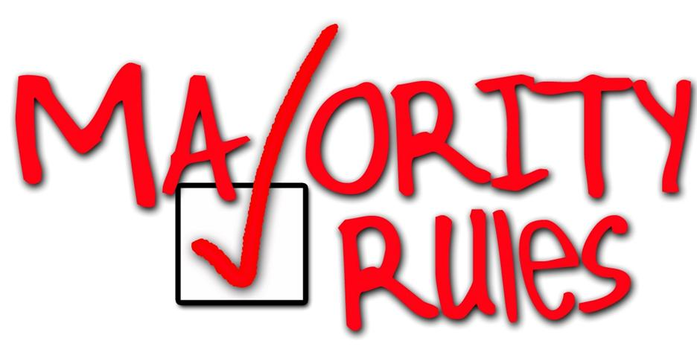
Hitler’s plan
Hitler's plan was to establish a majority of elected Nazis in the Reichstag which could pass whatever laws he desired while making it all perfectly legal.
On his first day as Chancellor, Hitler manipulated Hindenburg into dissolving the Reichstag and calling for the new elections he had wanted - to be held on March 5, 1933.

Slide 6
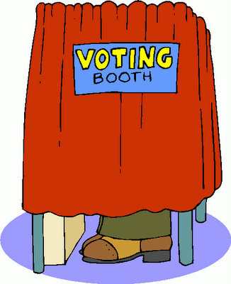
Elections
Hitler hoped new elections would help boost his support.
However, he feared the threat of the Communist Party who were also gaining support at this time.
Notes:
6

Slide 7
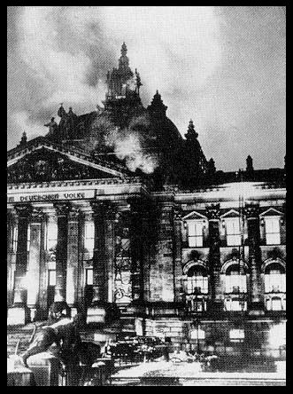
Reichstag Fire!
One week before the elections, on February 27th 1933, the Reichstag caught fire!
The Reichstag is the German parliament.
Notes:
7

Slide 8
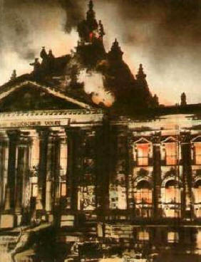
Reichstag fire
A number of small fires had been started around the building but most failed to take hold except the fire started in the great chamber.

Slide 9
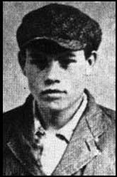


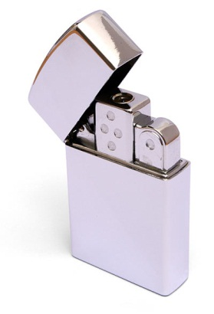
The Facts
At 10pm on 27th February 1933 the Berlin Fire Department received a call that the Reichstag building was on fire.
A young communist Marinus van der Lubbe was discovered on the premises.
He had matches and fire lighters in his pockets.
He said he had torched the Reichstag in protest against the Nazis.

Slide 10
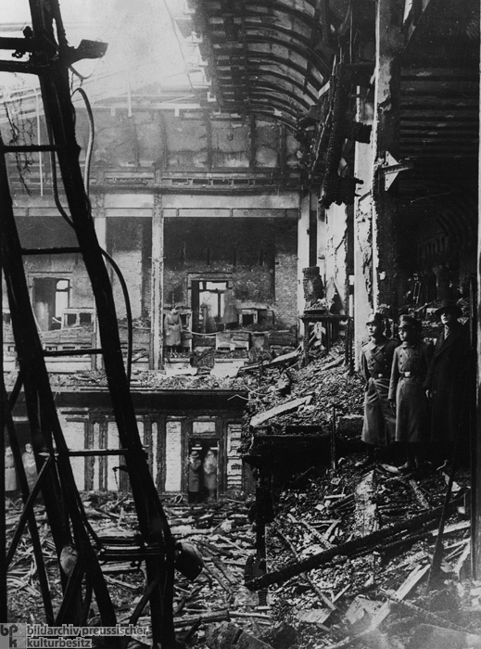
Notes:
10

Slide 11
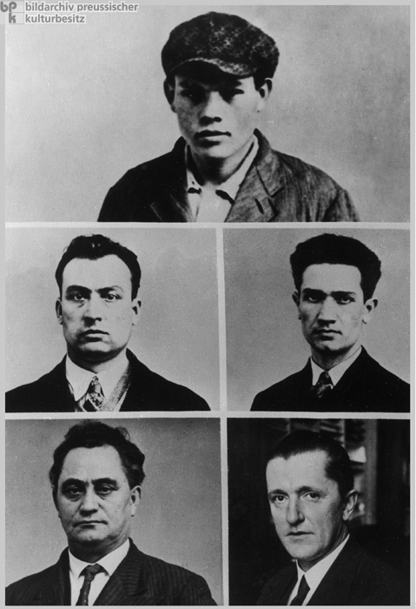
Who had the most to gain?
Van der Lubbe and four other communists were arrested and charged with arson and attempting to overthrow the government.
Although van der Lubbe confessed to the crime, many people believed that the real culprits were the Nazi Party, probably members of the SA.

Slide 12

Suspicious?
The Nazis said van der Lubbe was a member of the Communist Party.
However, the fire was found to have started in at least 20 different places AND large amounts of chemicals and petrol had been used.
Could one man do this?
Notes:
12

Slide 13
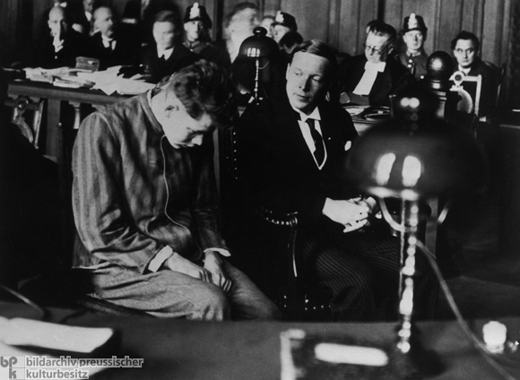

The Case Against the Communists
Van der Lubbe, a known Communist, was discovered on the premises.
He had organised Communist meetings in the past.
He confessed to the crime.

Slide 14
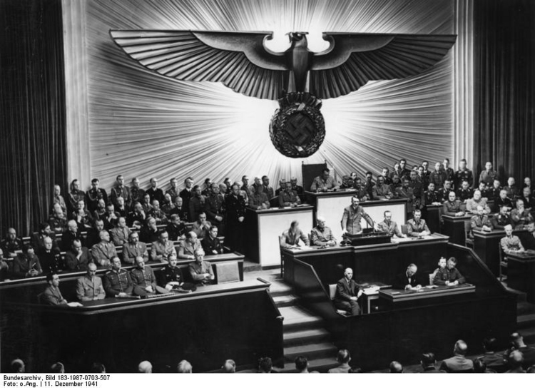
The Case Against the Nazi Party
The Nazi Party were the largest party in the Reichstag but did not have a clear majority.
Elimination of the Communist Party would give them a clear majority.
Notes:
14

Slide 15
The Case Against the Nazi Party
Would van der Lubbe would have been able to start fires which caused so much damage alone?
He had a history of mental illness and was unstable.
Karl Ernst, leader of the Berlin SA was overheard saying that if he had played a part in starting the fire he would be foolish to admit it.

Slide 16
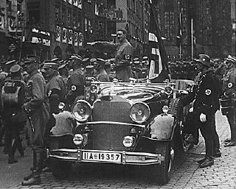
The Consequences
Hitler appeared at the Reichstag to give press interviews and blame the Communists.
The Nazis used the fire to round up Communists and arrest them.
Within hours 4,000 were arrested.
All Communist publications were banned .
The Communist Party was outlawed
Notes:
16

Slide 17
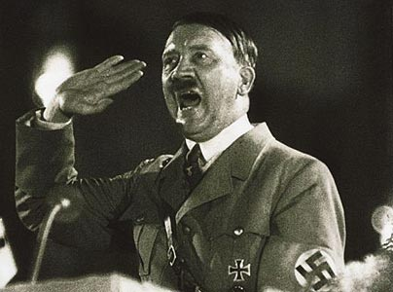
"The German people have been soft too long. Every Communist official must be shot. All Communist deputies must be hanged this very night. All friends of the Communists must be locked up. And that goes for the Social Democrats as well!"

Slide 18
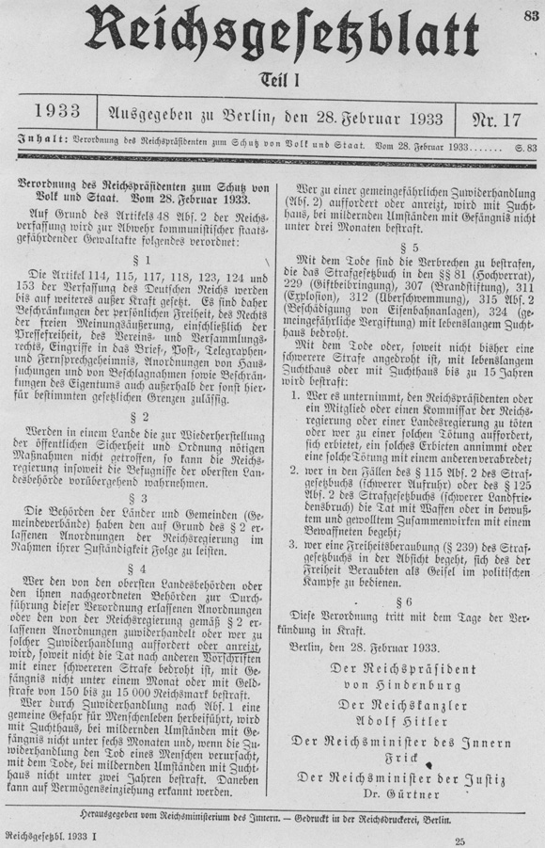
The Consequences
On 28th February 1933 Adolf Hitler went to see President Hindenburg and told him that the fire was the result of a Communist plot.
Hindenburg was convinced and signed the Order of the Reich President for the Protection of People and State, known as the Reichstag Fire Decree.
This took away basic rights.
Notes:
18

Slide 19
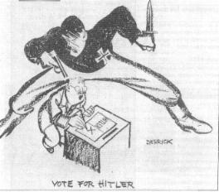
Reichstag Fire Law
Newspapers could be censored.
Meetings were limited.
Private letters and phone calls could be checked.
In the run up to elections political newspapers were shut down.
Notes:
19

Slide 20
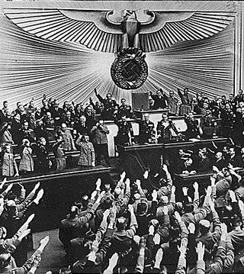
Election Day 5th March 1933
Nazi propaganda in the lead up to the election was stepped up.
In the elections the Nazi party got 288 seats (44% of the vote).
The German National People's Party, who supported the Nazi Party gained 8% of the vote. This gave Hitler a majority in the Reichstag.
This was a major step to complete control!
Notes:
20

Slide 21
What happened to the accused?
In July 1933 van der Lubbe and the four other accused men were tried on a charge of arson and attempting to overthrow the government.
Van der Lubbe, who confessed to the crime, was found guilty.
The others were acquitted as there was insufficient evidence against them.
Marinus van der Lubbe was beheaded on 10th January 1934.

Slide 22
Hitler’s Rise to power
Chancellor 30 Jan 1933:
(not majority/few Nazis in coalition government /Hindenburg could get rid of Hitler at any time)
Reichstag Fire 27 Feb 1933:
Arrest 1000’s communists/ Reichstag Fire Law

Slide 23
The Reichstag Fire Law….
28 February “DECREE FOR THE PROTECTION OF PEOPLE AND STATE”
Most civil rights were suspended, the power of government was strengthened, most Communists were arrested

Slide 24
Hitler’s Power
Elections 5 March 1933:
288 seats in Reichstag/crushed communist support/convinced Hindenburg that Germany was under threat
Enabling Act, 23 March 1933:
Hitler has complete power in Germany

Slide 25
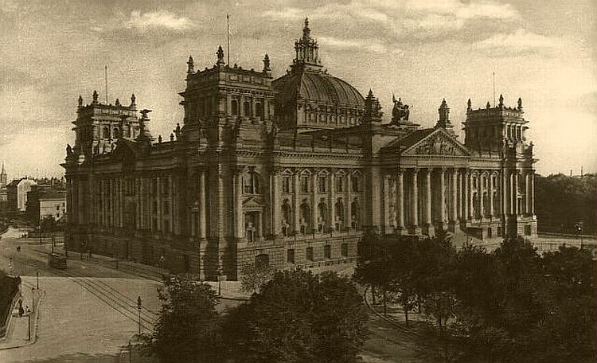
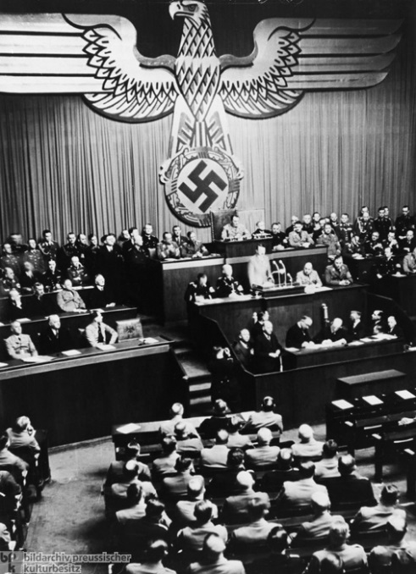
The Road to Dictatorship
On March 23, the Reichstag met in the Kroll Opera House in Berlin to consider passing Hitler's Enabling Act.
It was officially called the "Law for Removing the Distress of the People and the Reich."
If passed, it would in effect vote democracy out of existence in Germany and establish the legal dictatorship of Adolf Hitler.

Slide 26
Dictatorship?
During the Reichstag session on March 23, 1933, Hitler falsely claimed that this new law would not mean the abolition of the Reichstag.
He claimed he would use his new legislative authority over the next four years only in emergencies.

Slide 27
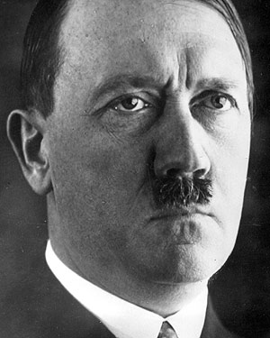
"The government will make use of these powers only insofar as they are essential for carrying out vitally necessary measures...The number of cases in which an internal necessity exists for having recourse to such a law is in itself a limited one"

Slide 28
The Enabling Act, 23 March 1933
5 clauses of this Act would give Hitler complete power to enact all laws in Germany during the next 4 years without approval from the Reichstag.
This was a recipe for dictatorship!
But…
Hitler needed two-thirds majority in the Reichstag to pass the act.
How could he achieve this?

Slide 29
Attitudes of the various parties at this time?
Communists | Already under arrest
Nationalists | Supported Hitler
Centre | Bought off by promises to make the R.C. Church safe
SPD | Totally against the Nazis

Slide 30
Getting the Enabling Act through
Enormous intimidation by the SA and SS
Eyewitness account by an SPD supporter:
“The wide square in front of the Kroll Opera House was crowded with dark masses of people. We were received with wild choruses :’ We want the Enabling Act!’ Youths with swastikas on their chests eyed us insolently, blocked our way, calling us names like ‘Centre pig’, ‘Marxist sow’ The Kroll opera House was crawling with armed SA and SS men... (who) lined the walls behind us in a semi-circle. Their expressions boded no good.”

Slide 31
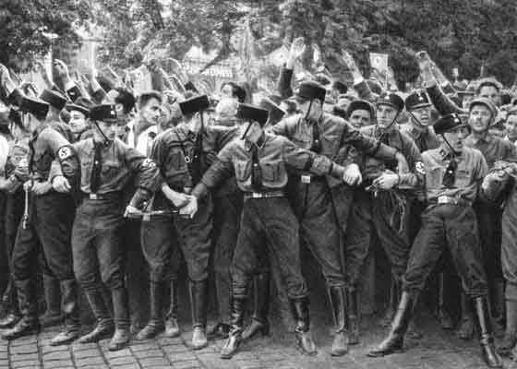
Intimidation
On the day of the vote, Nazi storm troopers gathered in a show of force around the opera house chanting, "Full powers - or else! We want the bill - or fire and murder!!"
They also stood inside in the hallways, and even lined the aisles where the vote would take place, glaring menacingly at anyone who might oppose Hitler's will.

Slide 32
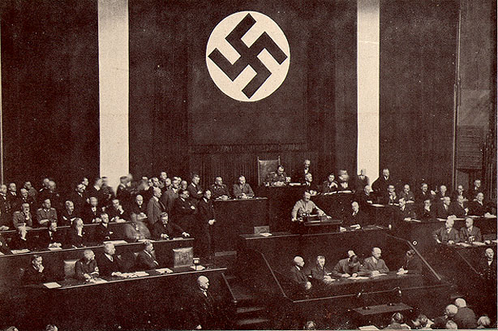
Hitler in the Kroll Opera House speaking about the Enabling Bill, 23 March 1933

Slide 33
2. The final vote
FOR = 441
AGAINST = 94
Democracy was ended. They had brought down the German Democratic Republic legally.

Slide 34
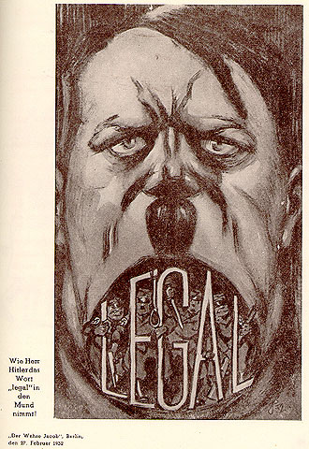
Result?
Hitler’s government was now a legal dictatorship.
Hindenburg lost his Presidential powers.
Within 3 months all other political parties were made illegal.
Trade Unions were banned.
By the end of 1933 over 150,000 political prisoners were in concentration camps.

