Slide 1
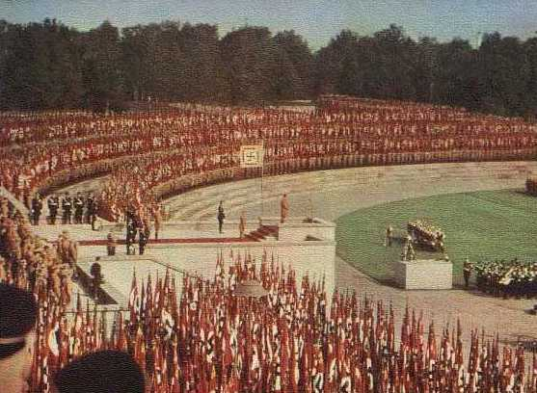
The Propaganda Machine
How did the Nazis use propaganda to strengthen their rule in Germany, 1933-1939?

Slide 2
What is propaganda?
Can you think of different types of propaganda that we are exposed to?
Propaganda comes from the word ‘propagate’, meaning to spread. It means the organised spreading of information to promote the views of a government or movement with the intention of persuading people to think or behave in a certain way.

Slide 3
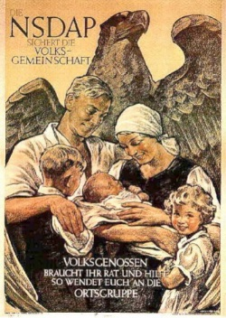
The Nazi Propaganda Machine
The Nazi regime was not maintained through the use of terror alone.
From the moment Hitler became Chancellor, propaganda played a key part in the maintenance of power.

Slide 4
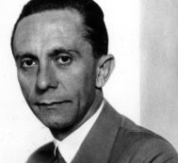
The Nazi Propaganda Machine
“I view the first task of the new ministry as being to establish co-ordination between the Government and the whole people… It is not enough for people to be more or less reconciled to our regime, to be persuaded to adopt a neutral attitude towards us, rather we want to work on people until they have capitulated to us, until they grasp ideologically that what is happening in Germany today is not an end in itself, but a means to an end. If the means achieves the end, the means is good. Whether it always satisfies stringent aesthetic criteria or not is immaterial.”
Goebbels, new Minister of Popular Enlightenment and Propaganda, at his first press conference, 15th March 1933

Slide 5
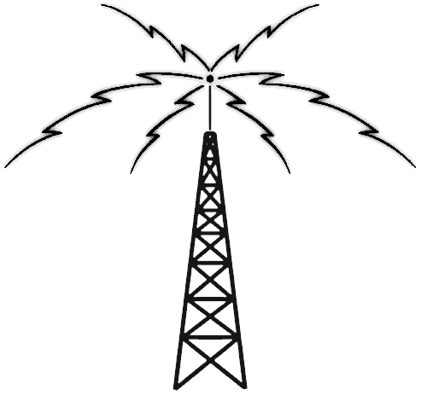
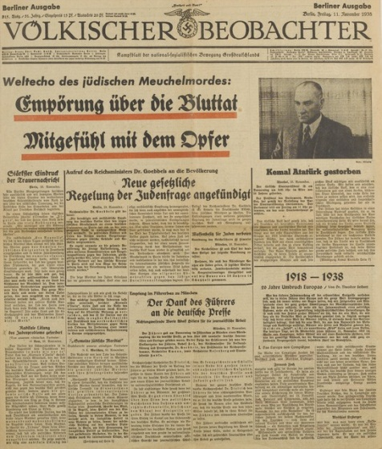
The Nazi Propaganda Machine
The Propaganda Ministry was a vital cog in the Nazi machine.
The two most important forms of propaganda were radio and the press.
Goebbels and Hitler recognised that the spoken word was more effective than the written.
To spread their word they utilised new media, like the radio.

Slide 6
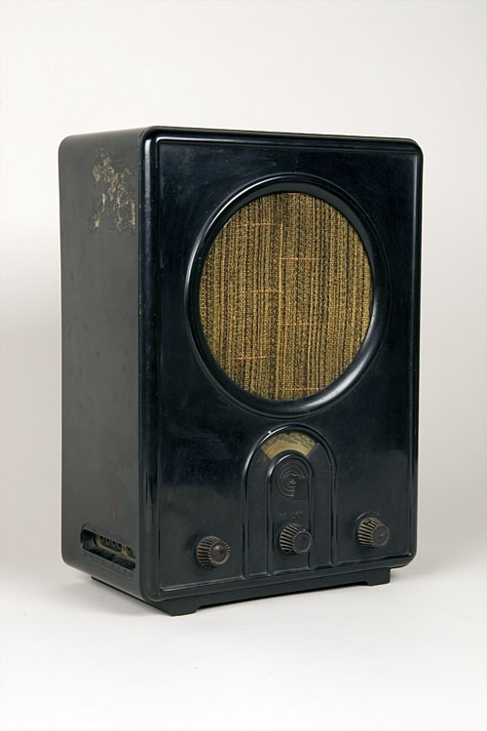
The Nazi Propaganda Machine
Once in power, Goebbels brought all German broadcasting under the control of the Nazis by creating the Reich Radio Company.
He also sacked 13% of the staff on political/racial grounds.
They were replaced by loyal Nazis.

Slide 7
The Nazi Propaganda Machine
“We make no bones about the fact that the radio belongs to us and no one else. And we will place the radio in the service of our ideology and no other ideology will have expression here… I am placing a major responsibility in your hands, for you have in your hands the most modern instrument in existence for influencing the masses. By this instrument you are the creators of public opinion.”
Hitler in a message to his broadcasters in March 1933

Slide 8
The Nazi Propaganda Machine
However, what use was control of broadcasting if the people had no means to receive it?
In 1932, less than 25% of German homes owned a radio.
To overcome this the Nazis produced a cheap radio called the People’s Receiver (Volksempfänger).
"People's Receiver" (Volksempfänger)

Slide 9
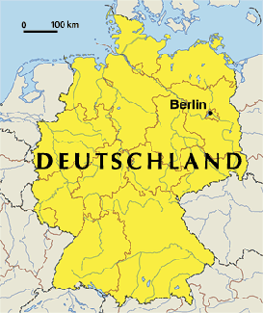
The Nazi Propaganda Machine
By 1939 70% of German homes had access to a radio = the highest national figure in the world.
Hence, radio became a means of mass communication for the Nazis.

Slide 10
The Nazi Propaganda Machine
Broadcasting was also directed at public places = no escape from the Nazi message.
Loudspeakers were put up in restaurants and cafes, factories and offices.
= all became venues for collective listening.

Slide 11
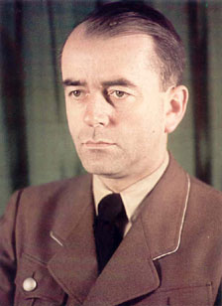
‘Through technical devices like the radio 80 million people were deprived of independent thought. It was thereby possible to subject them to the will of one man’
Albert Speer, Nazi Party member. Hitler’s chief architect.

Slide 12
Control of the Press
It was more difficult for Goebbels to control the press.
Germany had over 4,700 daily newspapers in 1933.
All papers were owned privately and owed no allegiance to central or local government.
Their loyalty was to their publishing company.

Slide 13
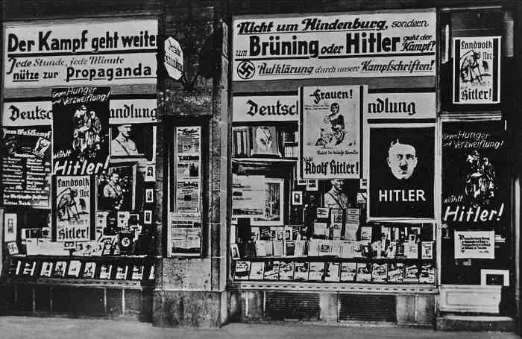
Control of the Press
How then did the Nazis gain control over the press?
Various measures were taken:
The Nazi publishing house, Eher Verlag, bought up numerous newspapers = by 1939 it controlled 2/3 of the German press.

Slide 14
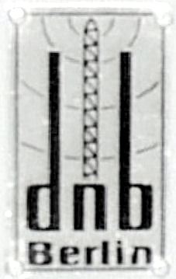
Control of the Press
Different news agencies (organisations that collect news items and distribute them to newspapers) were merged into one, the DNB (Deutsches Nachrichtenbüro).
The DNB was controlled by the government = news material was vetted even before it got to the journalists.

Slide 15
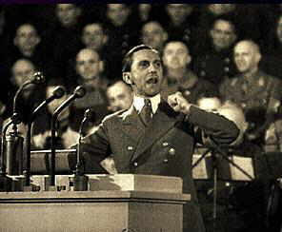
Control of the Press
Goebbels introduced a daily press conference at the Propaganda Ministry to provide guidance on editorial policy.
Lastly, the Editors Law was passed in October 1933.
This meant that newspaper content was made the sole responsibility of the editor.
= it was his job to satisfy the requirements of the Nazis, or face the consequences.
= no need for censorship!

Slide 16
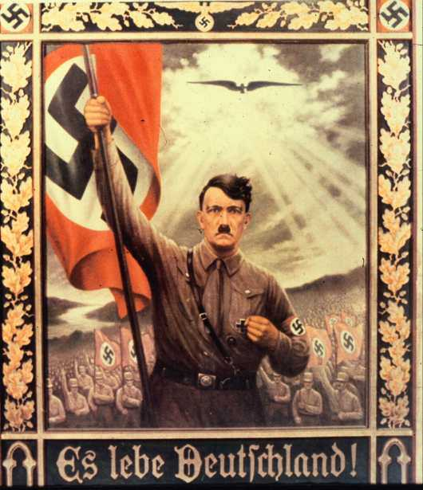
The Cult of the Leader
The Führer cult was a dominant theme in Nazi propaganda.
Hitler was portrayed as a messiah-type (God-like) figure.
His image was carefully promoted.

Slide 17
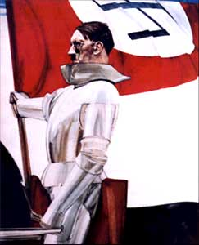
The Cult of the Leader
He was portrayed as someone who:
Personified the nation and stood aloof from selfish interests.
Understood the German people.
Was the architect of Germany's economic recovery.
Defended Germany against its enemies i.e. Jews, Communists, corrupt SA…
Was responsible for all the major successes of government.

Slide 18
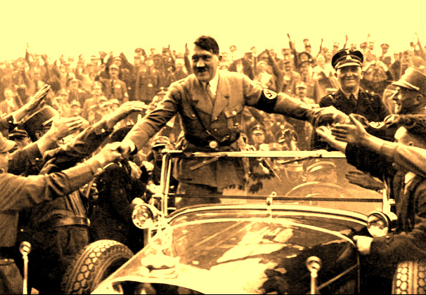
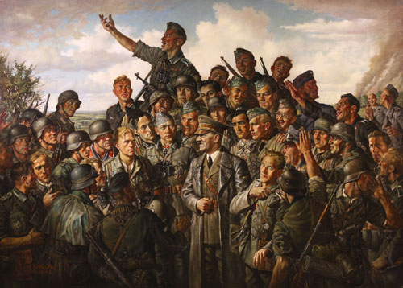
The Cult of the Leader
What were the effects of this ‘Hitler myth’?
It contributed to his great personal popularity.
By the late 1930s an estimate 90% of Germans admired him.
Only a small few rejected this Hitler myth.

Slide 19
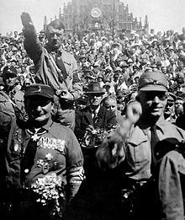
The Cult of the Leader
It sustained the regime and brought most Germans together.

Slide 20
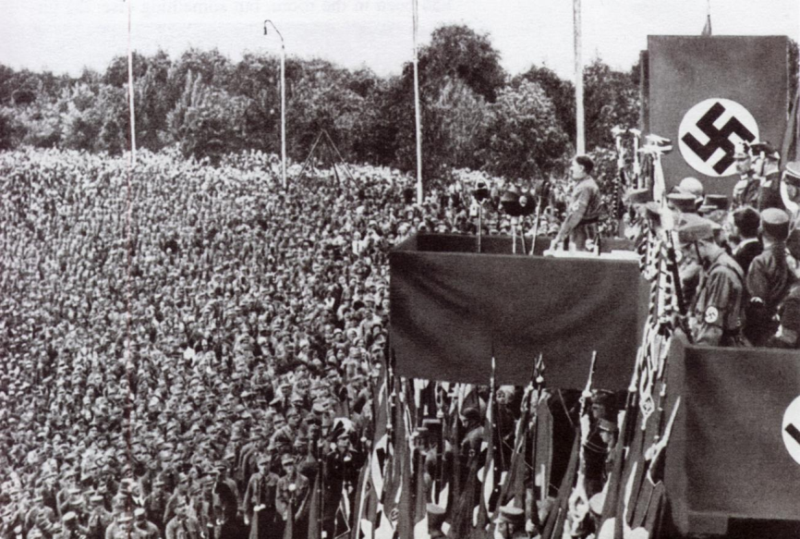
Rallies
One of the most effective ways of gaining support was through mass rallies.
Intention = to create an atmosphere so emotional that all members of the crowd would succumb to the collective will = people would react with their hearts not their minds.
This is the idea of ‘mass suggestion’.

Slide 21
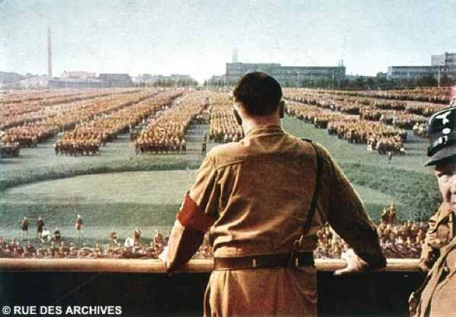
Rallies
Every kind of device was used to heighten the effect of the rallies:
Uniforms
Torches
Music
Salutes
Flags
Songs
Anthems
Speeches
Many people have since described how they were converted as a result of such meetings.

Slide 22
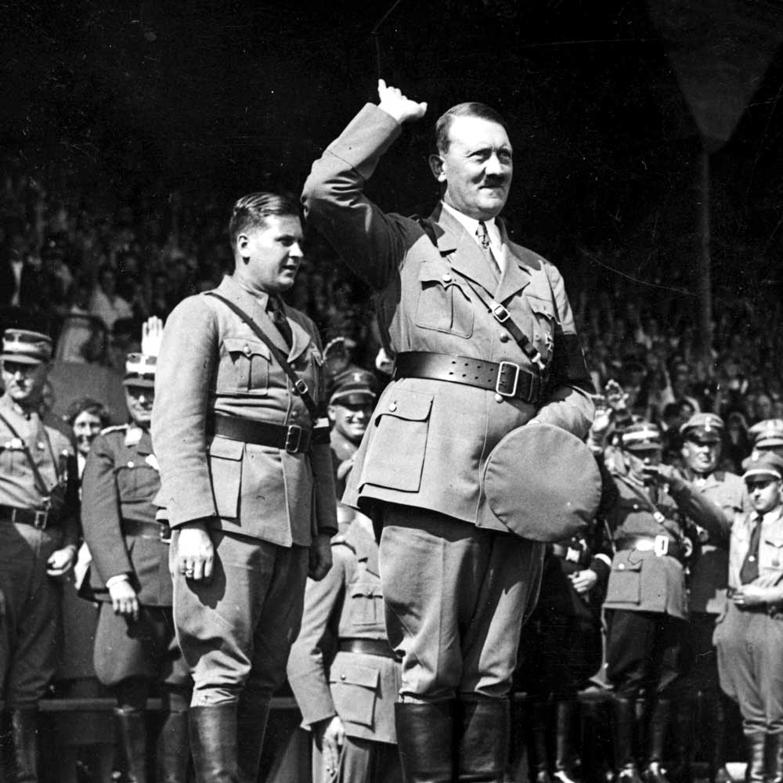
Devices used in rallies
Hitler would deliver a message tailored to his audience.
For example:
for the workers – jobs
for the farmers – fair prices
for the army – a promise to rearm
for the middle-classes the destruction of the Jews, whom he offered as a scapegoat for their suffering.

Slide 23
Control of the Press
Although control of the press and radio was Goebbels’ major objective, he gradually extended his influence so that film, music, literature and art all came under the control of the Reich.

Slide 24
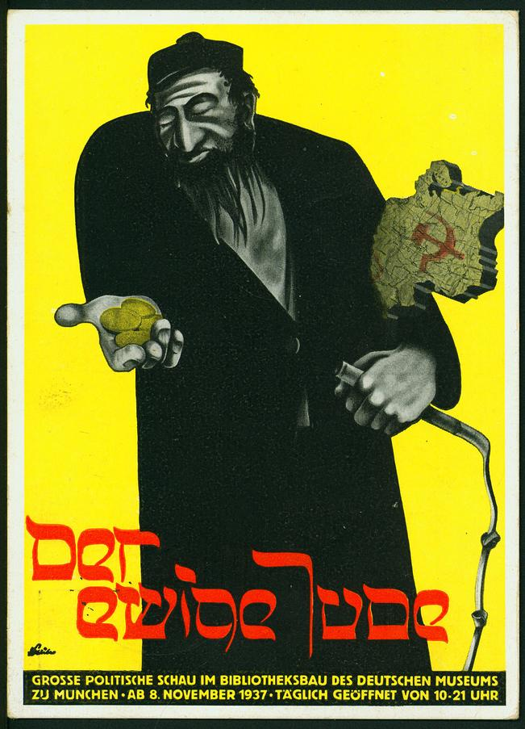
Films
The Nazis produced many films to promote their views.
Themes included the virtues of the Aryan type, German military and industrial strength, and the evils of the Nazi enemies.

Slide 25
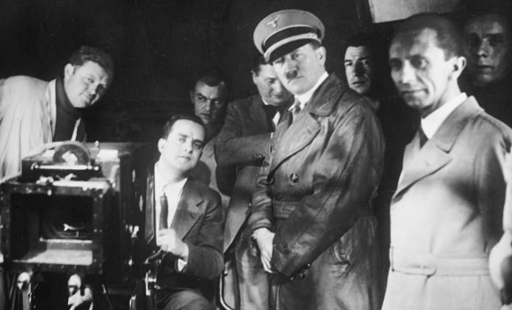
Films
Under Goebbels and Hitler, the German film industry became entirely nationalised.
Sometimes, the government would select the actors for a film, financing the production partially or totally, and would grant tax breaks to the producers.

Slide 26
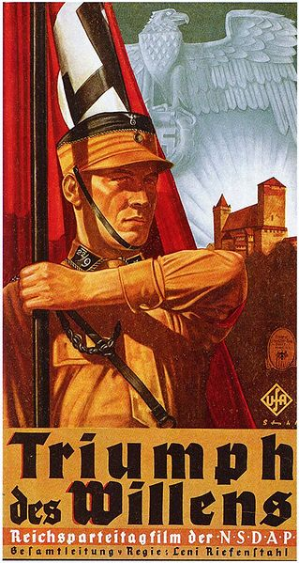
Triumph of the Will
Propaganda film made by Leni Riefenstahl.
Tells the story of the 1934 Nazi rally at Nuremberg.
Contains excerpts of speeches given by various leading Nazi’s.
Theme = return of Germany to a great power, with Hitler as the True German leader who will bring glory to the nation.
Released in 1935, became one of best known examples of propaganda in film history.

Slide 27
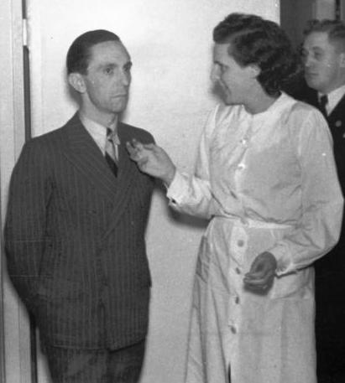
Shortly after he came to power Hitler called me to see him and explained that he wanted a film about a Party Congress, and wanted me to make it. My first reaction was to say that I did not know anything about the way such a thing worked or the organization of the Party, so that I would obviously photograph all the wrong things and please nobody — even supposing that I could make a documentary, which I had never yet done. Hitler said that this was exactly why he wanted me to do it. He wanted a film showing the Congress through a non-expert eye, selecting just what was most artistically satisfying — in terms of spectacle, I suppose you might say. He wanted a film which would move, appeal to, impress an audience which was not necessarily interested in politics

Slide 28
Triumph of the Will
Triumph of the Will premiered on 28 March 1935 at the Berlin Ufa Palace Theatre and was an instant success.
Hitler praised the film as being an "incomparable glorification of the power and beauty of our Movement."
Riefenstahl was rewarded with the German Film Prize, a gold medal at the 1935 Venice Biennale, and the Grand Prix at the 1937 World Exhibition in Paris.
The Independent wrote in 2003: "Triumph of the Will seduced many wise men and women, persuaded them to admire rather than to despise, and undoubtedly won the Nazis friends and allies all over the world.”

Slide 29
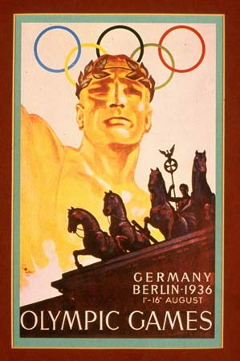
1936 Berlin Olympics
The 1936 Berlin Olympic Games had been handed to Berlin before the Nazis came to power but now it was the perfect opportunity for Hitler to demonstrate to the world how efficient the Nazi Germany was.
The Berlin Olympic Games gave the Nazis an opportunity to show off to the world.
49 countries were competing bringing with them their assorted media.

Slide 30
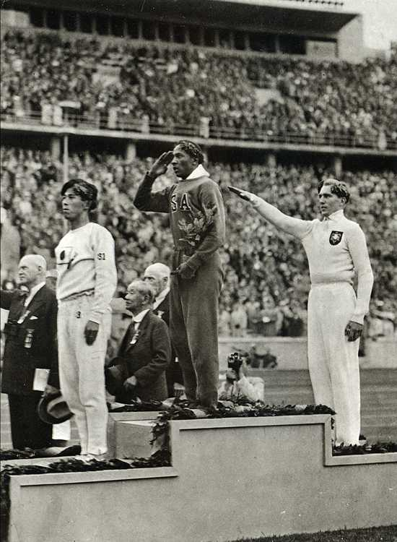
The Olympic Games
The Olympics were a perfect arena for the Nazi propaganda machine.
Perfect opportunity for Hitler to show the world how organised and impressive his regime was.
Intended to show Aryan supremacy + how much the Nazis had saved Germany.
The event was carefully choreographed- anti- Jewish posters were removed shortly before the event.

