Slide 1
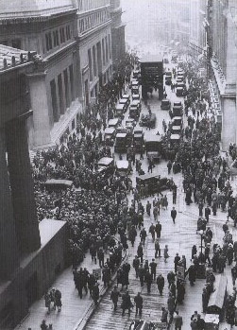
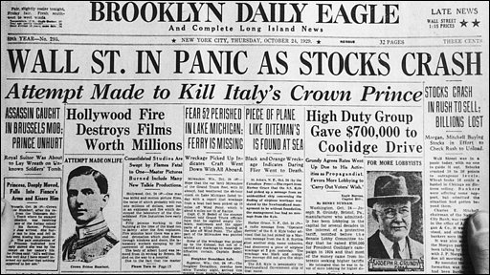
The Great Depression, 1929
What impact did the Wall Street Crash and Great Depression have in Germany?
How did the Great Depression aid the Nazis?

Slide 2
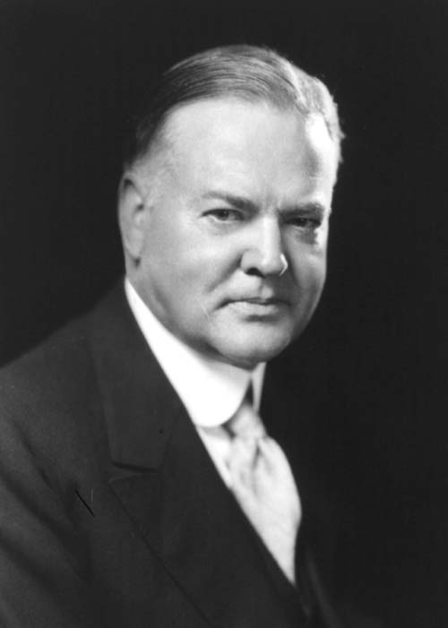
Wall Street Crash & the Depression
In 1928 the new Republican President Herbert Hoover confidently stated:
'We in America today are nearer to the final triumph over poverty than ever before in the history of any land.’
Herbert Hoover

Slide 3
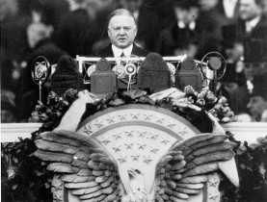
The Wall Street Crash
When he formally moved into the White House in March 1929 the mood of confidence was still there.
He pointed out that Americans had more bathtubs, oil furnaces, silk stockings and bank accounts than any other country.
6 months later it was a very different picture…
All confidence in the American economy had ended and America was plunged into the Great Depression.

Slide 4
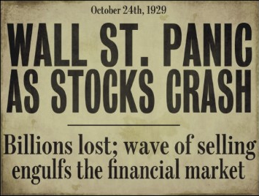
The Wall Street Crash
In October 1929 the Wall Street stock market crashed.
The American economy collapsed.
The USA entered a long depression that destroyed much of the prosperity of the 1920s.

Slide 5
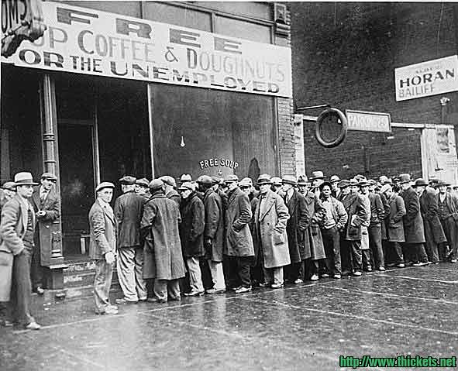
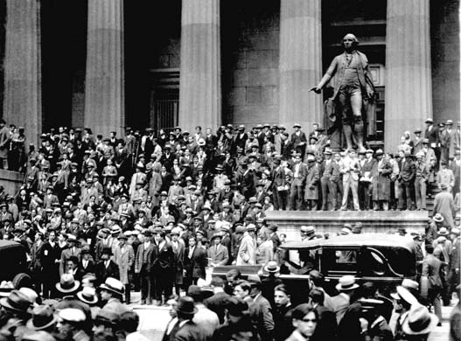
Wall Street Crash
When the American stock market collapsed it had a knock on effect around the world.
The world economy was plunged into the Great Depression.

Slide 6
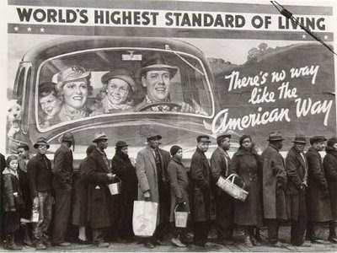
Effects in America
Between 1929-1932, over 100,000 businesses collapsed and 15 million people became unemployed.
As well as losing their jobs, many also lost their savings and homes.

Slide 7
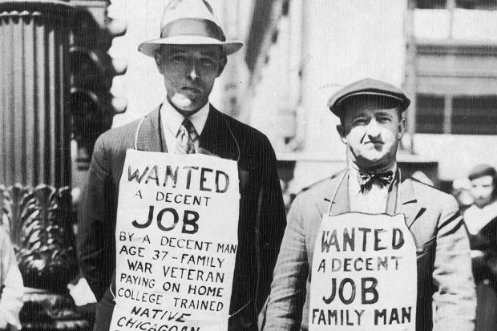
Effects in America
Between 1929 and 1933, on average 100,000 people lost their jobs every week.
By 1932, there were:
660,000 out of work in Chicago
1 million in New York City
50% of the population in Cleveland and 80% in Toledo were unemployed.

Slide 8
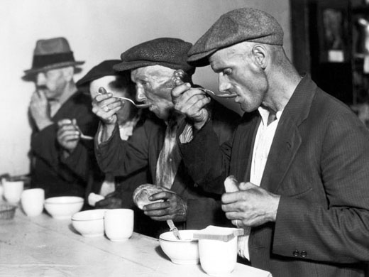
Effects in America
Newspapers stuffed under the shirt kept out the worst of the cold; and shoes could be lined with cardboard.
People sold their most precious possessions to buy food for their children.
Many died from exposure, and a large proportion of the population was suffering severe malnutrition.

Slide 9
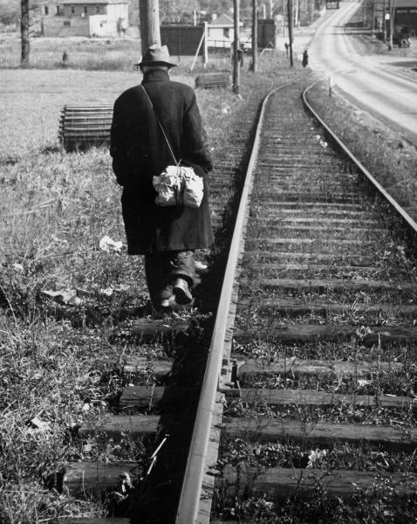
Effects in America
Many unemployed people became ‘hoboes’ – homeless wanderers seeking any kind of work.
By 1932 there were 1-2 million unemployed people wandering around the country, hitching rides or hopping onto freight trains or living in shanty towns on the outskirts of towns and cities.

Slide 10
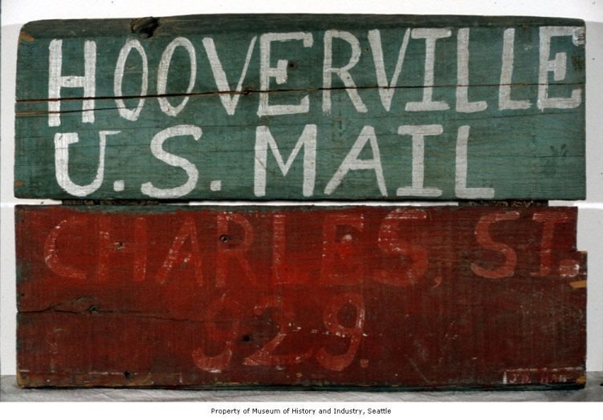
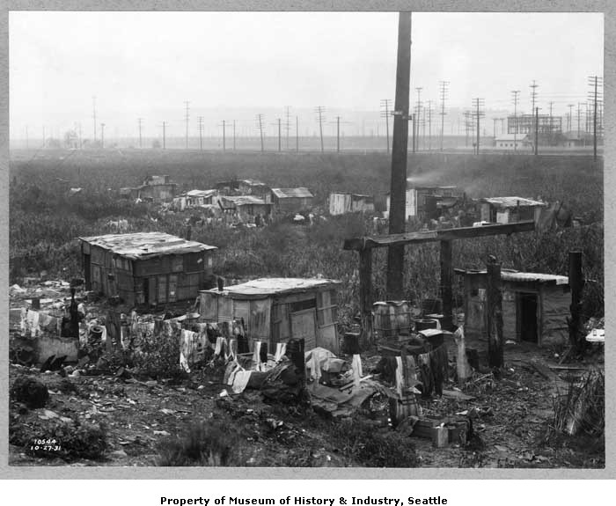
Effects in America
Homelessness was a massive problem.
Thousands of families, unable to pay their rent, were forced to take shelter in makeshift ‘homes’.
These ‘shanty towns’ grew up in cities and became known, sarcastically, as ‘Hoovervilles’.

Slide 11
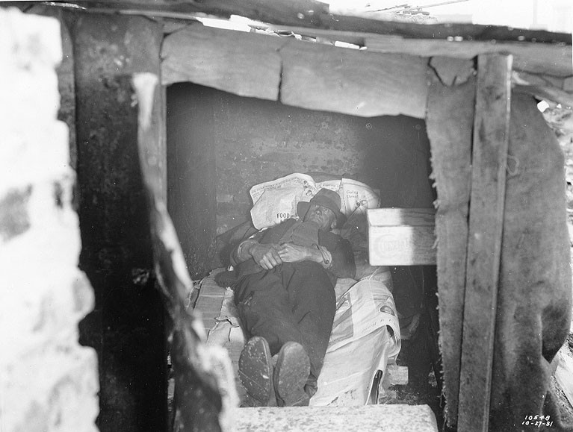

Slide 12
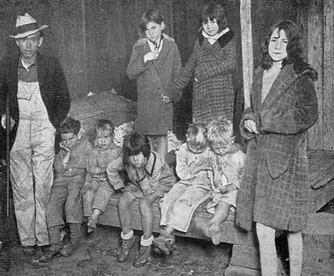
This family moved into a cave in Central Park, NYC.

Slide 13
What Caused the Great Depression?
There were too many goods being made and not enough people to buy them.
Farmers had produced too much food in the 1920s, so prices for their produce became steadily lower.
There were too many small banks - these banks did not have enough funds to cope with the sudden rush to take out savings, which happened in the autumn of 1929.

Slide 14
What Caused the Great Depression?
Too much speculation on the stock market - the middle class had a lot to lose and they had spent a lot on what amounted to pieces of paper.
America had lent huge sums of money to European countries. When the stock market collapsed, they suddenly recalled those loans.
This had a devastating impact on the European economy. The collapse of European banks caused a general world financial crisis.

Slide 15
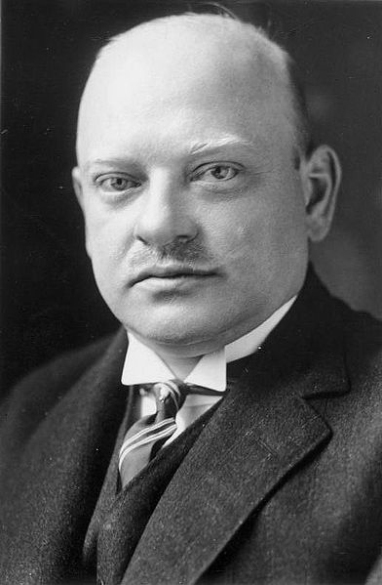
Global Impact: Wall Street Crash
“Germany is dancing on a volcano. If the short term credits are called in, a large section of our economy would crash” Stresemann 1928
After the crash American loans to Germany dried up.
Caused bankruptcy, bank failures and business collapses.
By January 1932 there were 6 million unemployed in Germany and over 50,000 businesses were bankrupt.
Stresemann

Slide 16
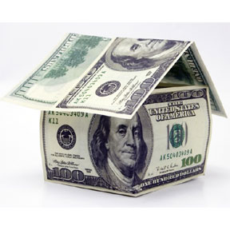
Germany
The German economy was especially vulnerable since it was built out of foreign capital, mostly loans from America and was very dependent on foreign trade.
When those loans suddenly came due and when the world market for German exports dried up, the German industrial machine quickly ground to a halt.

Slide 17
the Great Depression & the Nazis
The Great Depression is often considered to be the largest single factor in helping the Nazis rise to power.
Many historians argue that without the depression, and its devastating consequences for Germany, Hitler would have remained on the fringes of German politics.
The hardship brought to Germany, along with the damage caused to the Germany economy, ensured Hitler now had a receptive audience for his messages.
From this Hitler was able to build up mass popular support.

Slide 18
the Great Depression & the Nazis
In the Reichstag elections of 1930 the Nazis won 107 seats (up from 12 in the 1928 elections).
They received 18% of the popular vote and were now the second largest party.
In July 1932 they won 230 seats and 37% of the vote.

