Slide 1
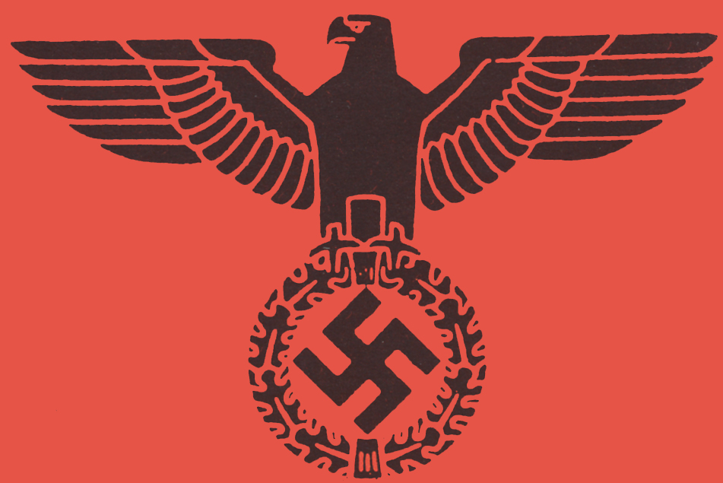
The Nazi Party
1924-1929

Slide 2
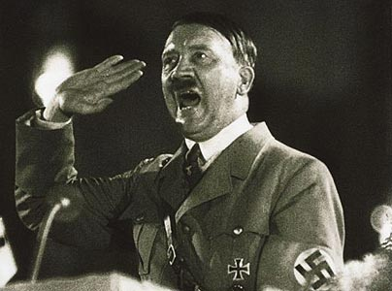
The Nazi Party
The Nazi Party did not exist in 1920 and enjoyed little mass support in the 1930s.
But by 1932 it was almost the biggest political party in Germany.
How was this achieved?

Slide 3
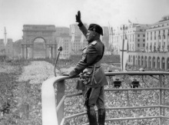
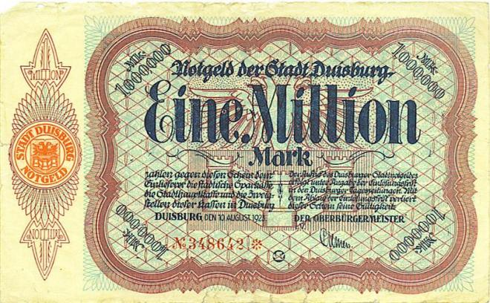
Growth of Power
In October 1922 Mussolini seized power in Italy.
In 1923 hyperinflation was destroying the lives of thousands in Germany.
These two events convinced Hitler that the opportunity to seize power had arrived.
Benito Mussolini
A one million Mark note, 1923

Slide 4
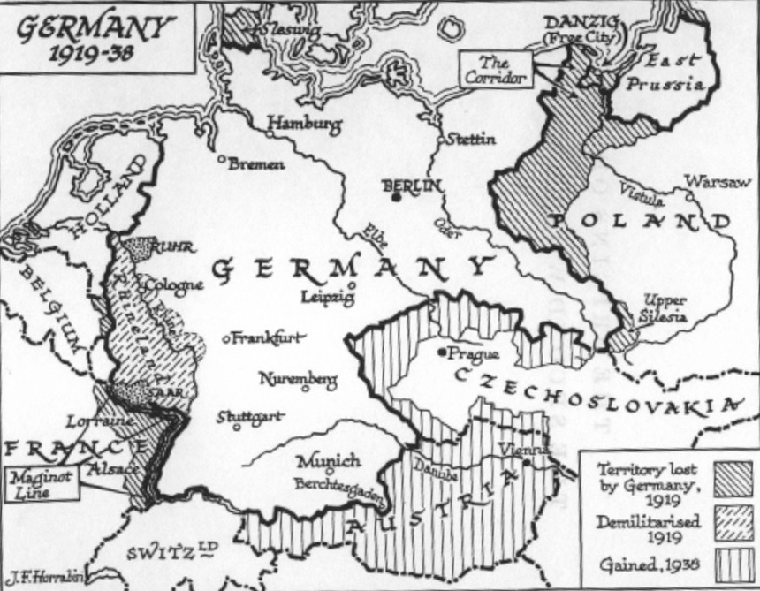
The Munich putsch (1923)
On 8 November 1923 Hitler and the Nazis attempted to seize power of the government of Bavaria.
The NSDAP, along with the SA, interrupted a political meeting that was being held in a beer hall in Munich.

Slide 5
The Munich putsch (1923)
Hitler jumped onto a table and fired a shot from his revolver up towards the ceiling.
He shouted:
The National Revolution has begun. This building is occupied by 600 heavily armed men. No one may leave the hall. The Bavarian and Reich governments have been removed and a provisional government formed. The army and police barracks are occupied. The army and the police are marching on the city under the swastika.”
Most of what Hitler said was not true.

Slide 6
The Munich putsch (1923)
The attempt to overthrow the government of Bavaria failed disastrously.
Hitler was caught and arrested soon after the fiasco.
He looked like a fool and was put on trial for high treason which carried a potential life sentence.
This may well have signalled the end of Hitler’s political career.

Slide 7
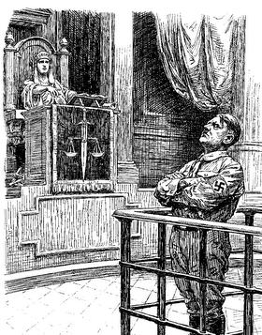
Hitler’s Trial
Hitler was tried in early 1924.
The judge and the jury at his trial had strong right-wing views.
During his trial Hitler was allowed to make a long political speech to the jury.

Slide 8
Trial
In his speech Hitler accepted full responsibility for the putsch. He said:
After his speech in court the jury cheered.
“I alone bear the responsibility, but I am not a criminal because of that. If today I stand here as a revolutionary, it is a revolutionary against the revolution. There is no such thing as High Treason against the traitors of 1918.”

Slide 9
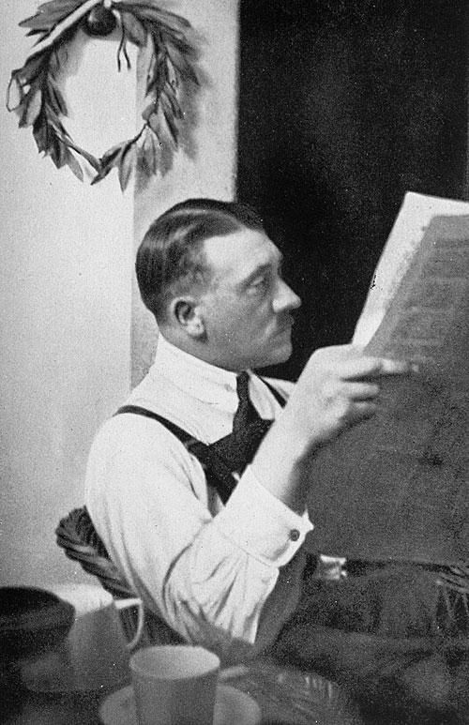
Prison
Hitler was sentenced to the minimum of five years in prison.
He served only nine months!
He was held at Landsberg Castle.
In prison Hitler was relatively comfortable. He was allowed his own bodyguards and even a secretary

Slide 10
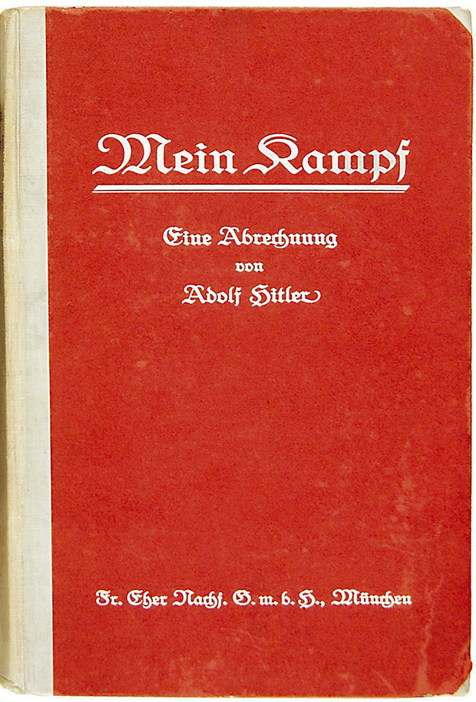
Prison
In prison Hitler used his time to think and plan.
During this time he wrote his autobiography “Mein Kampf” (My Struggle) which conveyed his political ideas and plans for the future.
He also finished the Party Programme which had been started in the early 1920s.

Slide 11
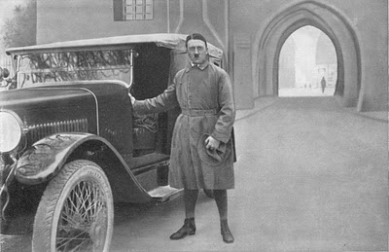
What happened after Hitler was released?
After being released from prison, Hitler took action to reform and build the Nazi Party

Slide 12
What happened after Hitler was released?
Hitler realised that power could only be won through winning votes in elections.
= the Nazi Party would have to focus on democratic methods to win support.
Aim?
Once the Nazis became important within the Reichstag, they would use their powers to destroy the Weimar democracy from within.

Slide 13
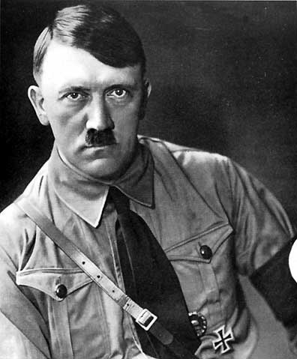
How did Hitler’s tactics change after Munich?
“We must hold our noses and enter the Reichstag”

Slide 14
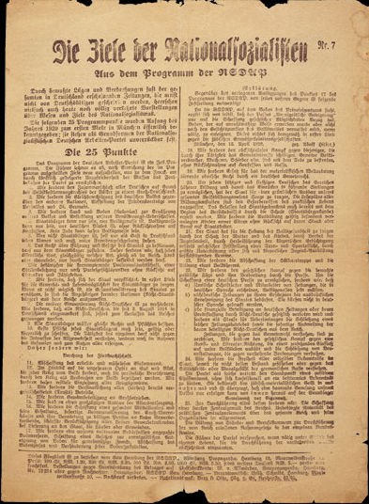
How did Hitler change the Party after his release?
The Party had been banned as a result of the putsch.
Two weeks after Hitler was released from prison (December 1924) the ban on the Party was lifted.
The Party was officially re-launched on the 27th Feb 1925.
The 25 point programme of the Nazi Party

Slide 15
Changes in the Party
Hitler set about reorganising the Party.
Aim?
To make it more effective in elections = win more votes.
Hitler needed to increase the Nazi Party’s popularity throughout Germany as before it had only been well known in Bavaria.
In order to gain a majority in the Reichstag he would need to win seats ALL across Germany.

Slide 16
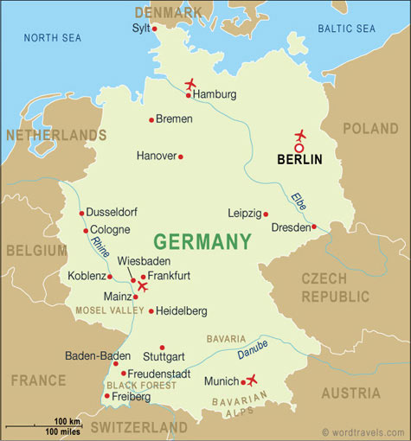
A National Party
To do this, Hitler set up Party branches across Germany = spread the Nazi message across Germany.
Party workers were well trained and motivated to spread the Nazi message.

Slide 17
Was Hitler successful in increasing Nazi support?
Between 1924-29 the Nazi Party did not do well in elections.
For example, in the 1928 Reichstag elections the Nazis only won 12 seats (2.6% of the vote).
During this period of the 1920s Germany was reasonably prosperous.
Whilst times were good most Germans were not likely to support the extreme policies put forward by the Nazis.
The Nazis called this period their “time of struggle”.

Slide 18
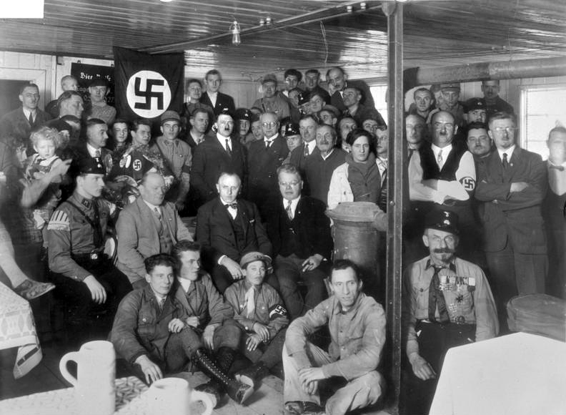
Was Hitler successful in increasing Nazi support?
However, whilst the Nazis failed to achieve success in elections during this period, they did build up a powerful position within right-wing German politics.
In 1929 there were over 100,000 members of the Nazi Party.

Slide 19
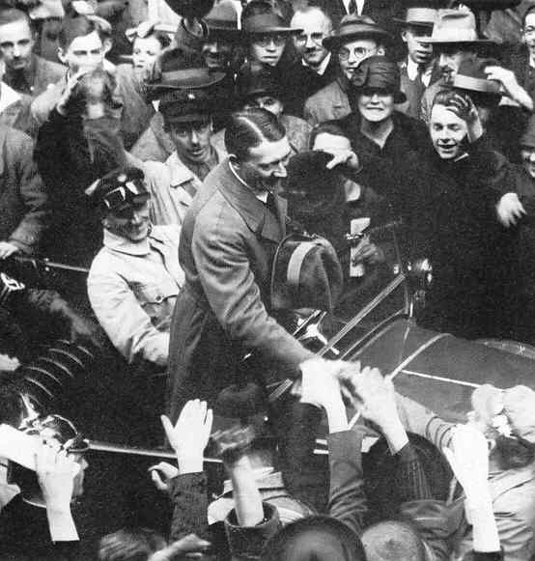
Was Hitler successful in increasing Nazi support?
In the second half of the 1920s Hitler set out his mission for Germany clearly.
He also built up unquestioning personal loyalty among his own supporters.
This meant that when economic disaster struck in 1929 many Germans were now ready to look for a strong new leader.
Hitler had positioned himself to successfully fill this role.

